Slide 1
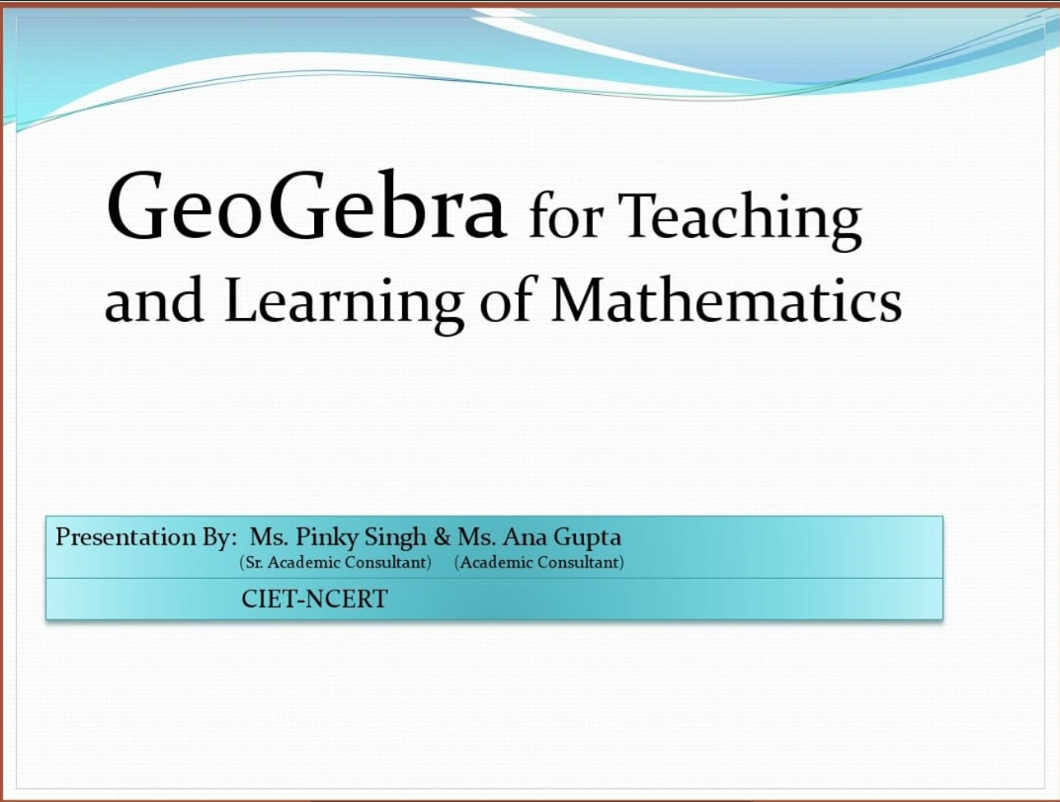

Slide 2
What is GeoGebra
GeoGebra is a dynamic mathematics software for all levels of education that brings together geometry, algebra, spreadsheets, graphing, statistics and calculus in one engine

Slide 3
Why GeoGebra?
GeoGebra comes with an easy-to-use interface and many features that help you create, modify, and share math simulations and models.
It comes with multiple platforms and dynamic math software that brings together tables, graphing, geometry, algebra, calculus, and statistics in a free easy-to-use package.

Slide 4
Uses and Features of GeoGebra
GeoGebra was created to help students gain a better understanding of mathematics.
Teachers and students can build animations , simulators
Ready to use applets are available
Practice mathematical experiments and discoveries both in classroom and at home
We can use it for active and problem-oriented teaching

Slide 5
Availability of GeoGebra
GeoGebra is open source software under the GNU General Public License and freely available at www.geogebra.org
You can access the online version: https://www.geogebra.org/classic
OR
Download as desktop app: https://www.geogebra.org/download

Slide 6
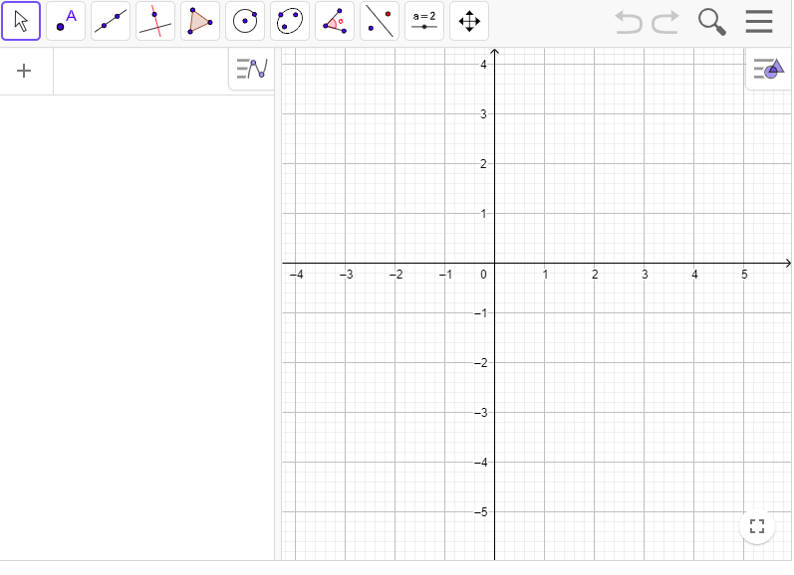
Home Page of GeoGebra
ALGEBRA WINDOW
GRAPHIC AND GEOMETRIC WINDOW

Slide 7
Graphing
Plot functions with sliders and solve equations
Geometry
Create interactive geometric constructions
3D Graphics
Graph functions, surfaces and many more 3D objects
CAS
Spreadsheet
Solve math problems with our powerful computer algebra system
Spreadsheet-Analyze data and do statistics connected with graphing
Probability
Visualize parameters and distributions quickly
Components of GeoGebra

Slide 8
Geogebra helps in visualisation of various concepts such as:
Basic Geometrical Ideas, Elementary shapes,, symmetry, practical geometry
Simple equation, lines and angles, triangles and its properties, Congruence of Triangles, perimeter and area, visualising solid shapes
Understanding quadrilateral, mensuration, introduction to graph, algebra

Slide 9
Secondry level concepts
Number Systems.
Polynomials, Algebraic Identities,
Coordinate Geometry
Linear Equations in Two Variables,
Introduction to Euclid's Geometry,
Areas of Parallelograms and Triangles, circles

Slide 10
THANK YOU

